Slide 1
Programming Languages and Technologies –Part3 & 4
Flowcharts and Pseudo code

Slide 2
Using Pseudo code statements and flowchart symbols

Slide 3
An Introduction to Algorithms and Pseudocode
A program must be systematically and properly designed before coding begins
This design process results in the construction of an algorithm

Slide 4
What Is an Algorithm?
An algorithm is like a recipe: it lists the steps involved in accomplishing a task
It can be defined in programming terms as a set of detailed, unambiguous and ordered instructions developed to describe the process necessary to produce the desired output from a given input

Slide 5
What Is Pseudocode?
Pseudocode, flowcharts, and Nassi-Schneiderman diagrams are all popular ways of representing algorithms
Flowcharts and Nassi-Schneiderman diagrams are covered in Appendices 1 and 2, while pseudocode has been chosen as the primary method of representing an algorithm because it is easy to read and write and allows the programmer to concentrate on the logic of the problem
Pseudocode is really structured English
It is English that has been formalized and abbreviated to look like high-level computer languages

Slide 6
Understanding Program Data
Information processed by the computer is data.
a single variable, such as an integer or a character, or
a group item (sometimes called an aggregate), such as an array, or a file

Slide 7
Variables, Constants, and Literals
A variable is the name given to a collection of memory cells, designed to store a particular data item
It is called a variable because the value stored in those memory cells may change or vary as the program executes
Example
total = num1 + num2

Slide 8
Variables, Constants, and Literals
A constant is a data item with a name and a value that remain the same during the execution of the program
A literal is a constant whose name is the written representation of its value

Slide 9
Data Types
At the beginning of a program, the programmer must clearly define the form or type of data to be collected
The data types can be elementary data items or data structures

Slide 10
Elementary Data Items
An elementary data item is one containing a single variable that is always treated as a unit
The most common elementary data types are:
— Integer: holds a whole number
— Real: holds a decimal value, or is a number with a fractional part
— Character : holds a symbol such as a through z, 1 through 9, or !, @,#,$,%,^, etc
— Boolean: holds either a value of true or false.

Slide 11
Data Structures
A data structure is an aggregate of other data items
The data items that it contains are its components, which may be elementary data items or another data structure
The most common data structures are:
— Records: a collection of data items or field related to each other
— File: a collection of records
— Array: a collection of data items, all of the same type!
— String: a collection of zero or more characters.

Slide 12
Files
There are two different methods of storing data on files:
Sequential or text files
Direct or random-access files

Slide 13
Data Validation
Data should always undergo a validation check before it is processed by a program
Different types of data require different checks – for example:
Correct type — Correct range
Correct length — Completeness
Correct date

Slide 14
Summary
The steps in program development were introduced and briefly described below:
Define the problem
Outline the solution
Develop the outline into an algorithm
Test the algorithm for correctness
Code the algorithm into a specific programming language
Run the program on the computer
Document and maintain the program

Slide 15
Summary
Three different approaches to program design were introduced, namely procedure-driven, event-driven, and data-driven
An algorithm was defined as a set of detailed, unambiguous and ordered instructions developed to describe the processes necessary to produce the desired output from the given input
Pseudocode is an English-like way of representing the algorithm

Slide 16
Flowcharts and Pseudocode

Slide 17
Programming Tools
Three tools are used to convert algorithms into computer programs:
Flowchart - Graphically depicts the logical steps to carry out a task and shows how the steps relate to each other.
Pseudocode - Uses English-like phrases with some Visual Basic terms to outline the program.

Slide 18
Problem solving example
How many stamps do you use when mailing a letter?
One rule of thumb is to use one stamp for every five sheets of paper or fraction thereof.

Slide 19
Algorithm
1. Request the number of sheets of paper; call it Sheets. (input)
2. Divide Sheets by 5. (processing)
3. Round the quotient up to the next highest whole number; call it Stamps. (processing)
4. Reply with the number Stamps. (output)

Slide 20
Flowcharts
Graphically depict the logical steps to carry out a task and show how the steps relate to each other.

Slide 21
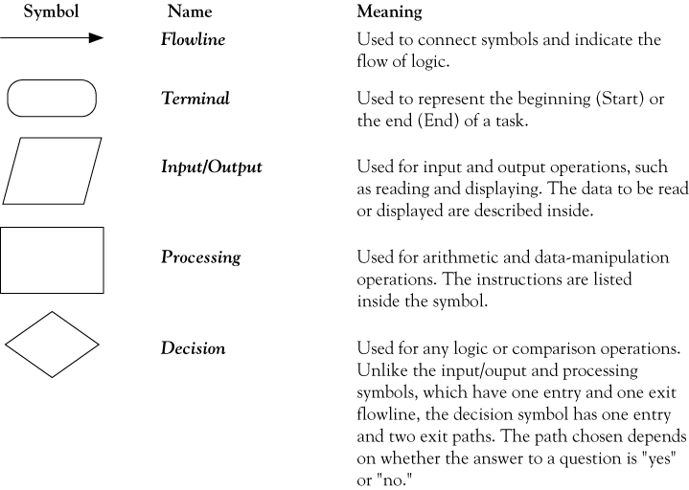
Flowchart symbols

Slide 22
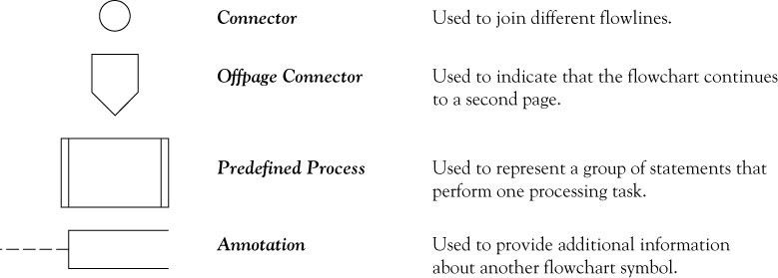
Flowchart symbols continued

Slide 23
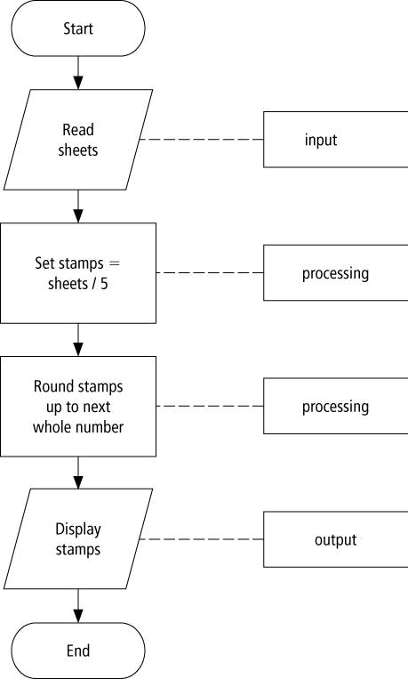
Flowchart example

Slide 24
Pseudocode
Uses English-like phrases to outline the task.

Slide 25
Pseudocode example
Determine the proper number of stamps for a letter
Read Sheets (input)
Set the number of stamps to Sheets / 5 (processing)
Round the number of stamps up to the next
whole number (processing)
Display the number of stamps (output)

Slide 26
Divide-and-conquer method
Used in problem solving – take a large problem and break it into smaller problems solving the small ones first
Breaks a problem down into modules

Slide 27
Statement structures
Sequence – follow instructions from one line to the next without skipping over any lines
Decision - if the answer to a question is “Yes” then one group of instructions is executed. If the answer is “No,” then another is executed
Looping – a series of instructions are executed over and over

Slide 28
Sequence flow chart

Slide 29
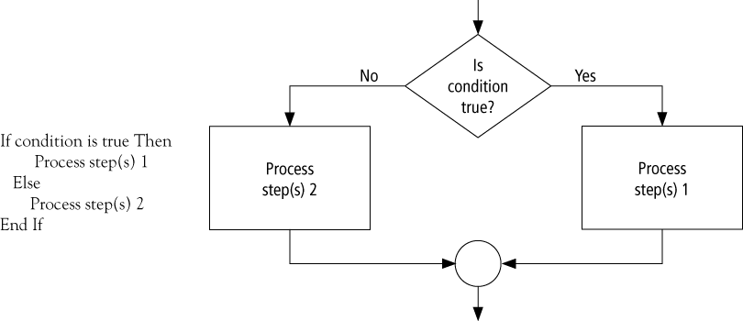
Decision flow chart

Slide 30
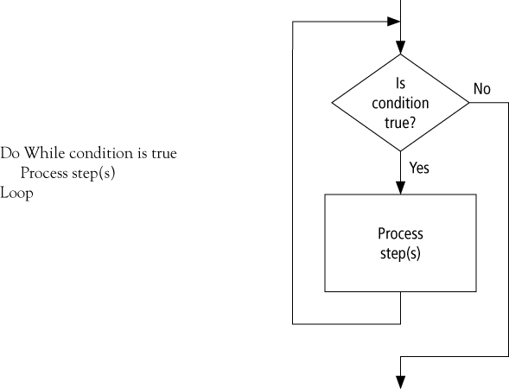
Looping flow chart

Slide 31
Direction of Numbered NYC Streets Algorithm
Problem: Given a street number of a one-way street in New York City, decide the direction of the street, either eastbound or westbound
Discussion: in New York City even numbered streets are Eastbound, odd numbered streets are Westbound

Slide 32
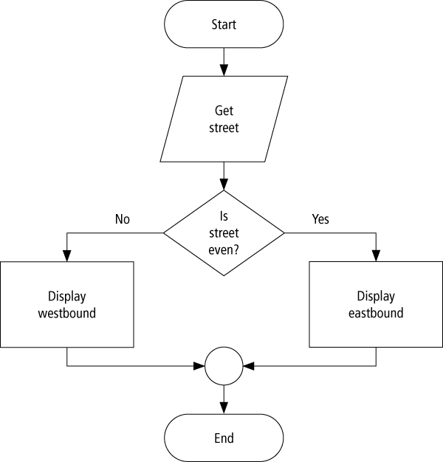
Flowchart

Slide 33
Pseudocode
Program: Determine the direction of a numbered NYC street
Get street
If street is even Then
Display Eastbound
Else
Display Westbound
End If

Slide 34
Class Average Algorithm
Problem: Calculate and report the grade-point average for a class
Discussion: The average grade equals the sum of all grades divided by the number of students
Output: Average grade
Input: Student grades
Processing: Find the sum of the grades; count the number of students; calculate average
Notes:
We need a loop to read and then add (accumulate) the grades for each student in the class. Inside the loop, we also need to total (count) the number of students in the class. See Figures 2.8 to 2.10.
grade = sum of grades / number of students.

Slide 35
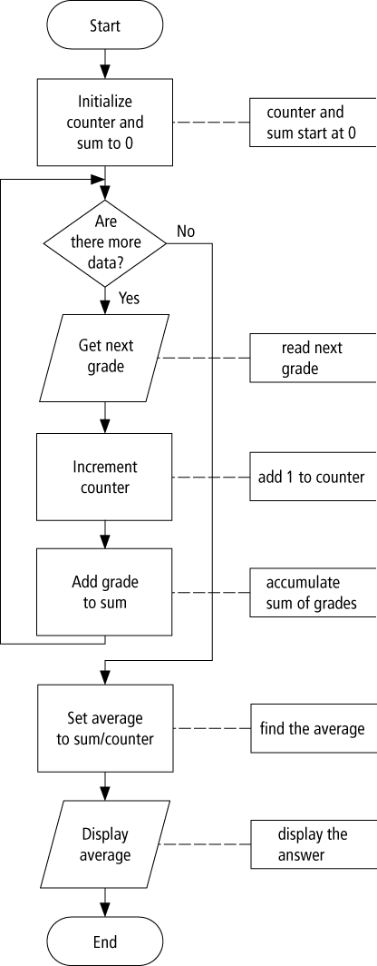
Flowchart

Slide 36
Pseudocode
Program: Determine the average grade of a class
Initialize Counter and Sum to 0
Do While there are more data
Get the next Grade
Add the Grade to the Sum
Increment the Counter
Loop
Computer Average = Sum / Counter
Display Average

Slide 37
Tips and tricks of flowcharts
Flowcharts are time-consuming to write and difficult to update
For this reason, professional programmers are more likely to favor pseudocode and hierarchy charts
Because flowcharts so clearly illustrate the logical flow of programming techniques, they are a valuable tool in the education of programmers

Slide 38
Tips and tricks of pseudocode
There are many styles of pseudocode
Some programmers use an outline form
Some use a form that looks almost like a programming language
The pseudocode in the case studies of this text focus on the primary tasks to be performed by the program and leaves many of the routine details to be completed during the coding process

Slide 39
Programming Models

Slide 40
Programming Models
Recently, a number of different approaches to program design have emerged, the most common being:
Procedure driven programming
Object –based programming
Object-oriented programming (OO)

Slide 41
Procedure-Driven Programming Model
The procedure-driven approach to program design is based on the idea that the most important feature of a program is ‘what’ it does – that is, its processes or functions

Slide 42
Procedure-Driven Programming (Contd.)
Example
A program to execute a sales order may be divided into:
order entry module
data verification module
Inventory update module

Slide 43
Procedure-Driven Programming (Contd.)
In procedure-driven programming, the sequence of operations for an application is determined by a central controlling program (e.g., a main procedure).
The program determines in advance what will be done and in which order. The program starts at the beginning, occasionally calls subroutines

Slide 44
Object-Oriented Programming
Object-oriented programming is also based on decomposing the problem; however, the primary focus is on the things that make up the program
The object-oriented programming paradigm introduced mechanisms required to obtain modular software design and reusability compared to universal accessibility of implementations by imperative programming.
The main part of the object-oriented paradigm is related to the introduction of classes which cover basic properties of concepts to be implemented.

Slide 45
Object Oriented Programming
Object (instance)
State (fields)
Behavior (methods)
Identity
Class
code describing implementation of an object
Data Abstraction
Modularity
Encapsulation
Inheritance
Polymorphism
Notes:
Object : run-time entity; associated storage
Class : usually available only at compile-time

Slide 46
Abstraction
General: Focus on the meaning
Suppress irrelevant “implementation” details
Programming Languages :
Assign names to recurring patterns
Value : constant identifier
Expression : function
Statements : procedure
Control : loop, switch
Value/ops : interface

Slide 47
Data Abstraction
Focus on the meaning of the operations (behavior), to avoid over-specification.
The representation details are confined to only a small set of procedures that create and manipulate data, and all other access is indirectly via only these procedures.
Facilitates code evolution.
Notes:
pop(push(I,S)) = I vs array/list impl.
Have more freedom in choosing potential implementation strategies.
Clear separation/decoupling of clients and servers (implementation) using the interface and documenting the behavior.

Slide 48
Data Abstraction : Motivation
Client/user perspective (Representation Independence)
Interested in what a program does, not how.
Minimize irrelevant details for clarity.
Server/implementer perspective (Information Hiding)
Restrict users from making unwarranted assumptions about the implementation.
Reserve right to change representation to improve performance, … (maintaining behavior).
Notes:
CAR : Interface and behavior : Steering, brakes, …
Different models, different implementation
Upgrades --- performance improvement,
same functionality

Slide 49
Data Abstraction : Examples
Queues (empty, enQueue, deQueue, isEmpty)
array-based implementation
linked-list based implementation
Tables (empty, insert, lookUp, delete, isEmpty)
Sorted array (logarithmic search)
Hash-tables (ideal: constant time search)
AVL trees (height-balanced)
B-Trees (optimized for secondary storage)
Notes:
Spec: Correctness concerns
Impl: Perofrmance concerns

Slide 50
Object based programming
In a programming sense, the term "object-based language" may be used to describe any programming language that is based on the idea of encapsulating state and operations inside "objects". Object-based languages need not support inheritance or polymorphism .
While Object oriented language support all feature of OOPS i.e. Inheritance, polymorphism etc. In Object Oriented Language there is no built in type of objects are available but in Object Based Language Build in type object are available like window object in javascript.

Slide 51
Object based programming
For ex: JavaScript is an Object Based Language, it can build actual objects from a constructor function and it has almost any feature that any object could have such as Constructor, functions (Methods), Properties, Instances etc.
But, Javascript is not an Object Oriented Programming Language because it has no feature that fits the requirements of the definition of Object Oriented Programming Language such as Inheritance, Polymorphism etc.

